Slide 1
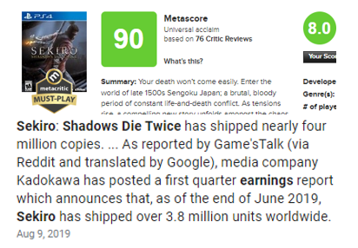
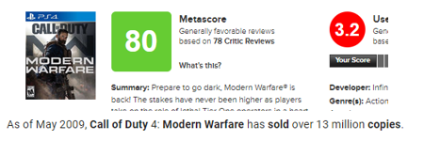
Balancing Brand Building with Revenue in the Gaming Industry

Slide 2
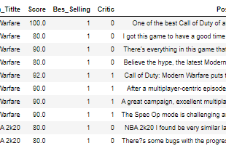
Web Scraped Data of Positive Reviews

Slide 3
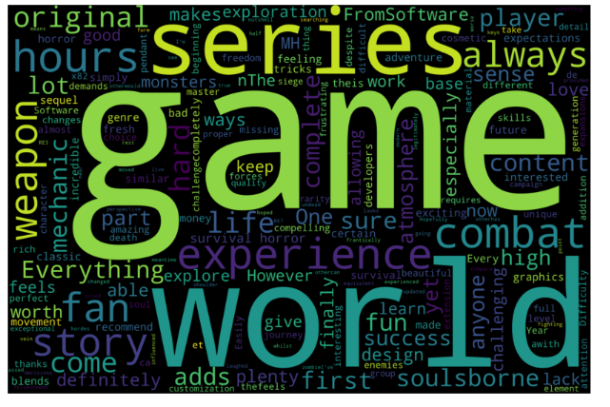
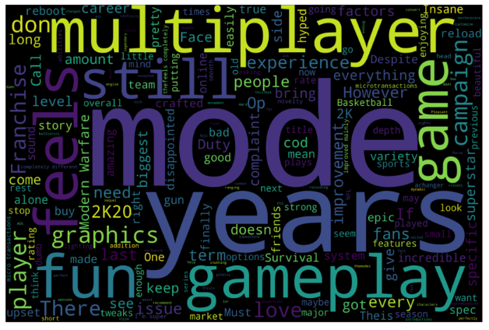
Critically Successful, Average Sales
Critically Average, Top Sales

Slide 4
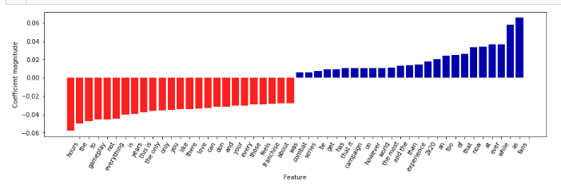
How important the use of a word is in defining a critical versus fan pleasing game

Slide 5
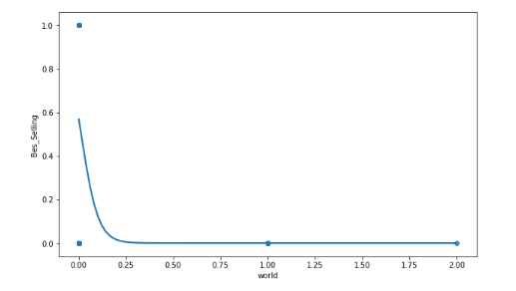
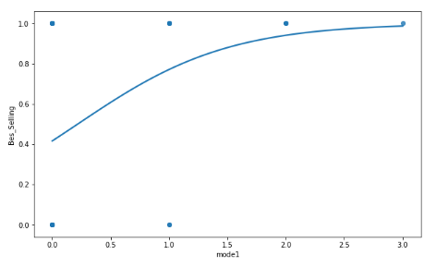
Use of word “world” in critical reviews
Use of word “mode” in critical reviews

Slide 6

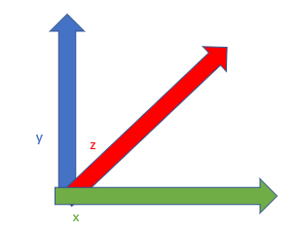
Defining games along n-dimensional axis of features – A Feature Space of Features

Slide 7
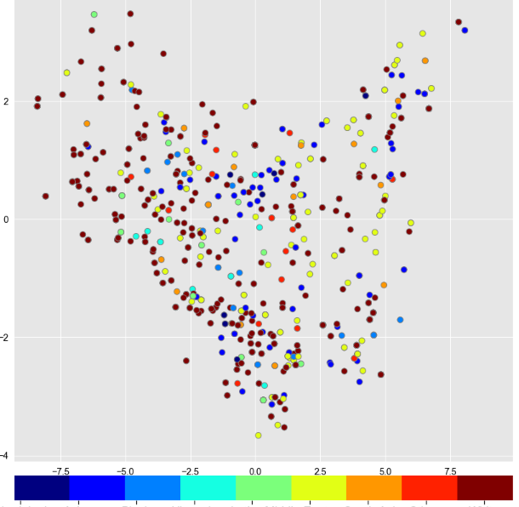
Feature Space Example

